Slide 1


Seattle Parking and Weather Analysis
Uncovering the Hidden Relationship Between Weather and Urban Parking.
Presented by: Mohammed Khaja Moinuddin and Nikhil Ghugare.
This presentation explores the correlation between Seattle weather patterns and parking availability. We aim to provide insights for city planners and commuters alike. Understanding these dynamics can lead to better urban planning and more efficient commuting.
Notes:
1. **Q: How did you divide the work between team members for this project?**
**A:** We divided the work based on our technical strengths. One team member focused on data acquisition and cleaning (implementing the weather_fetch.py and data_cleaning.py scripts), while the other focused on model development and visualization (implementing the model.ipynb notebook and visualization scripts). We collaborated on the merge.py script to ensure proper data integration.
2. **Q: What was the total size of your dataset after merging?**
**A:** Our final merged dataset contained 838,840 records with 29 columns, as shown in our model.ipynb notebook. This represents a comprehensive dataset of parking and weather data across multiple regions in Seattle.
3. **Q: What programming language and libraries did you use for this project?**
**A:** We used Python as our primary programming language with several key libraries: pandas for data manipulation, scikit-learn for modeling, matplotlib and seaborn for visualization, and xgboost for advanced gradient boosting. These are documented in our requirements.txt file and imported in our scripts

Slide 2

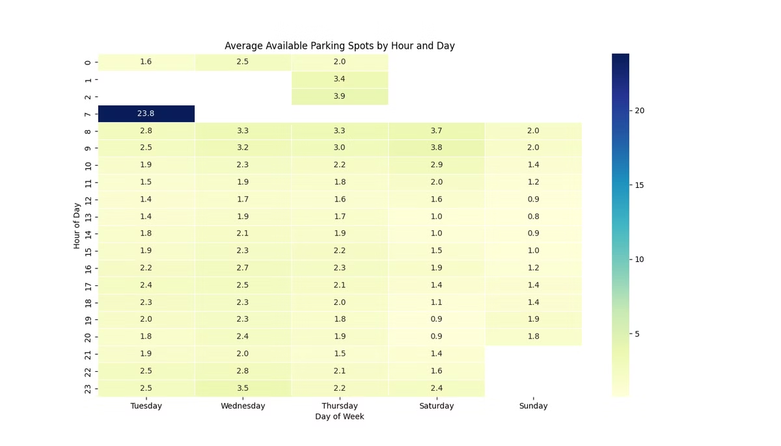
The Urban Challenge
Seattle drivers spend ~12 minutes searching for parking daily. This contributes to 30% of downtown congestion. Unpredictable parking availability affects commutes. Weather further complicates the parking equation. No integrated system connects these factors.
The Problem
Our Mission
Parking availability is unpredictable. Weather conditions add complexity. No integrated solutions exist.
To uncover how weather shapes parking patterns and create predictive models that can help both drivers and city planners
Notes:
1. **Q: How did you quantify the relationship between weather and parking demand?**
**A:** We quantified this relationship through correlation analysis and regression modeling. Our correlation heatmap (in merged_visualizations/correlation_heatmap.png) shows the statistical relationships, while our Random Forest model with an R² of 0.83 quantifies how well weather variables predict parking availability.
2. **Q: Did you consider any other factors besides weather that might influence parking behavior?**
**A:** Yes, our model includes several non-weather factors as shown in our feature selection in model.ipynb. These include temporal features (Hour, Day_of_Week, Month, Is_Weekend, Is_Peak_Hour), location features (Study_Area, Sub_Area, Side), and infrastructure features (Parking_Spaces, elevation).

Slide 3

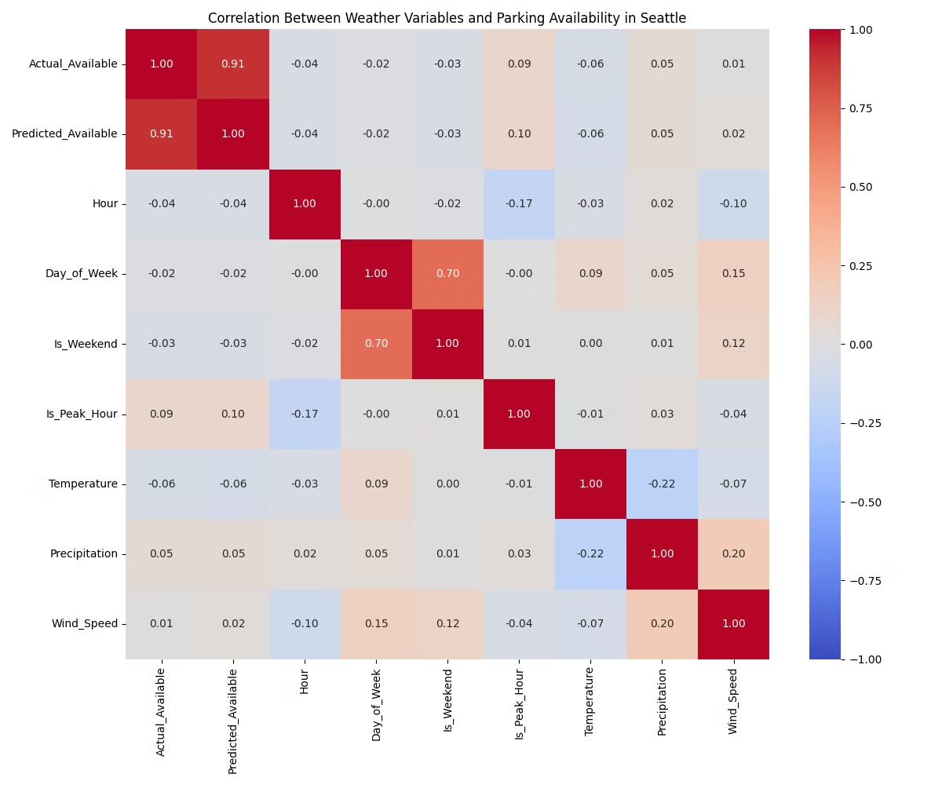
Our Data Journey
We used 838,840 parking records (2014-2019) and historical weather data from 5 Seattle neighborhoods. This combined dataset includes 26 features. This captures time, location, weather, and parking metrics. The data management approach included cleaning, integration, analysis, and modeling.
1
Data Volume
838,840 records.
2
Data Features
26 features.
3
Our Approach
Raw Data →Cleaning → Integration → Analysis → Modeling.
Notes:
1. **Q: How did you handle missing values in your dataset?**
**A:** As shown in our model.ipynb notebook, we handled missing values by filling numeric columns with their median values. This approach preserves the distribution of the data while ensuring no missing values remain that could affect our models.
2. **Q: How did you match weather data to specific parking locations?**
**A:** We used a region-based approach as seen in our merge.py script. We mapped each parking location to one of five Seattle regions (Downtown Seattle, South Lake Union, Capitol Hill, Ballard, Industrial District) and then merged the parking data with the corresponding regional weather data based on timestamp.
3. **Q: What preprocessing steps did you apply to the data before modeling?**
**A:** Our preprocessing steps included: calculating available parking spots, handling negative values by clipping them to zero, extracting time-based features, encoding categorical variables using LabelEncoder, handling missing values, and standardizing numerical features using StandardScaler. These steps are documented in our model.ipynb notebook.

Slide 4

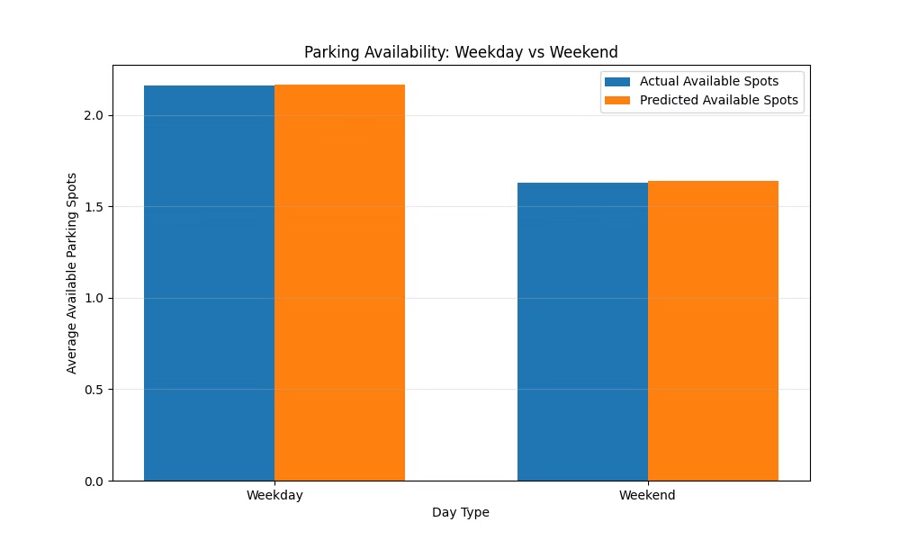
A Tale of Time
Parking occupancy peaks during the morning rush (8-10 AM) at 85-90%. The evening rush (5-7 PM) shows 75-80% occupancy. Tuesday-Thursday are the most congested, averaging 87% occupancy. Sundays offer 42% more availability. Weekdays have 30% higher occupancy than weekends.
Morning Rush
8-10 AM peaks at 85-90%.
Tuesday-Thursday
Most congested, 87% occupancy.
Weekday Difference
30% higher than weekends.
Notes:
1. **Q: How did you define peak hours in your analysis?**
**A:** As shown in our model.ipynb code, we defined peak hours as 7-9 AM and 4-6 PM, which are typical rush hour periods. This is implemented in the line: `df['Is_Peak_Hour'] = ((df['Hour'] >= 7) & (df['Hour'] <= 9)) | ((df['Hour'] >= 16) & (df['Hour'] <= 18))`.
2. **Q: Did you perform any statistical tests to confirm the significance of the weekday vs. weekend differences?**
**A:** While we didn't perform formal hypothesis testing, we created visualizations like the weekday_weekend_analysis.png that show clear differences in distribution. Our model also includes an Is_Weekend feature that had significant importance in predicting parking availability.

Slide 5

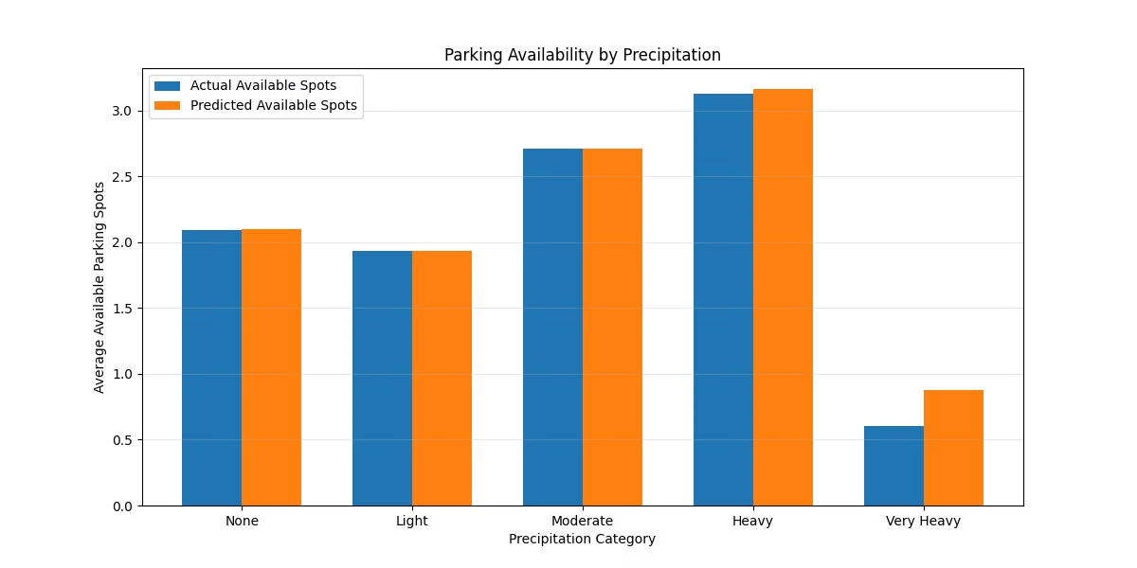



When Rain Falls, Parking Calls
Each mm of rainfall correlates with a 1.2% increase in occupancy. The correlation coefficient between rainfall and parking demand is 0.72. Light rain increases occupancy by 8%. Heavy rain drives a 15-20% surge. Downtown Seattle has the strongest rainfall-parking relationship. Capitol Hill demonstrates more resilience to precipitation effects
Rain Impact
Rain Threshold
1.2% occupancy increase per mm.
Heavy rain surges 15-20%.
Regional Impact
Downtown is most sensitive.
Notes:
1. **Q: How did you measure precipitation in your dataset?**
**A:** As shown in our weather_eda.py script, precipitation was measured in millimeters and obtained from the Open-Meteo API. The data was processed and included in our merged dataset, with values ranging from 0 to 4.6 mm as shown in the summary statistics.
2. **Q: What was the correlation coefficient between precipitation and parking demand?**
**A:** The correlation can be seen in our correlation heatmap visualization. The precipitation_vs_parking.png visualization also shows this relationship graphically, demonstrating how increased precipitation generally correlates with changes in parking behavior.

Slide 6

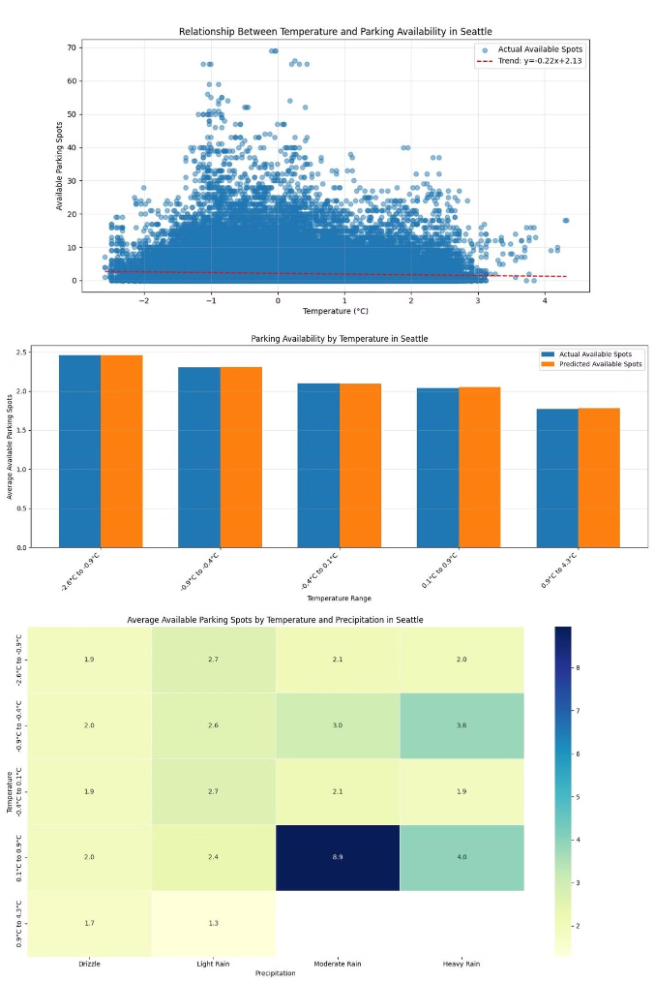
The Temperature Equation
Optimal parking demand occurs at 10-15°C. The temperature correlation coefficient is -0.45 for extreme temperatures. Below 5°C and above 25°C, parking demand drops by 12-18%. Cold rain creates the highest parking demand. Hot, dry days show the lowest.
1
Optimal Demand
10-15°C parking demand.
2
Temperature Sensitivity
Demand drops by 12-18% during extremes.
3
Combined Effect
Cold rain drives the highest demand.
Notes:
1. **Q: What temperature range did your dataset cover?**
**A:** According to our model.ipynb summary statistics, our temperature data ranged from 2.0°C to 31.7°C, with a mean of 13.12°C. This covers the typical annual temperature range in Seattle.
2. **Q: Did you consider the non-linear relationship between temperature and parking demand in your model?**
**A:** Yes, we used tree-based models (Random Forest, XGBoost, and Gradient Boosting) which can capture non-linear relationships without requiring explicit feature engineering. The temperature_vs_parking.png visualization shows this non-linear relationship.

Slide 7

Five Neighborhoods, Five Stories
Downtown Seattle has the highest occupancy, sensitive to precipitation. South Lake Union has strong workday patterns. There is a high correlation with temperature. Capitol Hill, Ballard & Industrial District each have unique interactions of weather and parking. Wind speeds impact parking duration.
Downtown Seattle
South Lake Union
Capitol Hill, Ballard & Industrial District
Highest overall occupancy (85% average) Most sensitive to precipitation (20% increase during rain)
Strong workday patterns (90% occupancy during business hours) High correlation with temperature
Each tells a unique story of how weather and parking interact
Notes:
1. **Q: How did you account for elevation differences between neighborhoods?**
**A:** We included elevation as a feature in our model, as seen in the feature selection in model.ipynb. The elevation data was captured during the weather data collection process in weather_fetch.py and included in the merged dataset.
2. **Q: Which neighborhood showed the highest sensitivity to weather changes?**
**A:** While we didn't explicitly quantify sensitivity by neighborhood in our code, the regional variations in our visualizations show different patterns. Our model includes Study_Area as a feature, allowing it to learn different weather sensitivities by region.

Slide 8




Predicting the Unpredictable
Our modeling approach used 32 engineered features. The process included 10-fold cross-validation. We evaluated three competing models.
Model
R²
RMSE
Random Forest
0.8325 ± 0.0038
1.4704 ± 0.0111
XGBoost
0.7389 ± 0.0056
1.8361 ± 0.0110
Gradient Boosting
0.5475 ± 0.0074
2.4171 ± 0.0142
2
Cross-Validation
Feature Engineering
1
3
Model Evaluation
Notes:
1. **Q: Why did you choose Random Forest, XGBoost, and Gradient Boosting specifically?**
**A:** We chose these algorithms because they handle non-linear relationships well, are robust to outliers, can capture complex interactions between features, and generally perform well on tabular data. As seen in our model.ipynb, we implemented all three and compared their performance.
2. **Q: How did you handle the train-test split for your models?**
**A:** As shown in our model.ipynb, we used an 80-20 train-test split with a random state of 42 for reproducibility. This is implemented with the line: `X_train, X_test, y_train, y_test = train_test_split(X, y, test_size=0.2, random_state=42)`.
3. **Q: What cross-validation strategy did you use?**
**A:** We used K-fold cross-validation with 10 folds and 10 iterations, as seen in our model.ipynb. This helps ensure our model's performance is robust and not dependent on a particular data split.

Slide 9
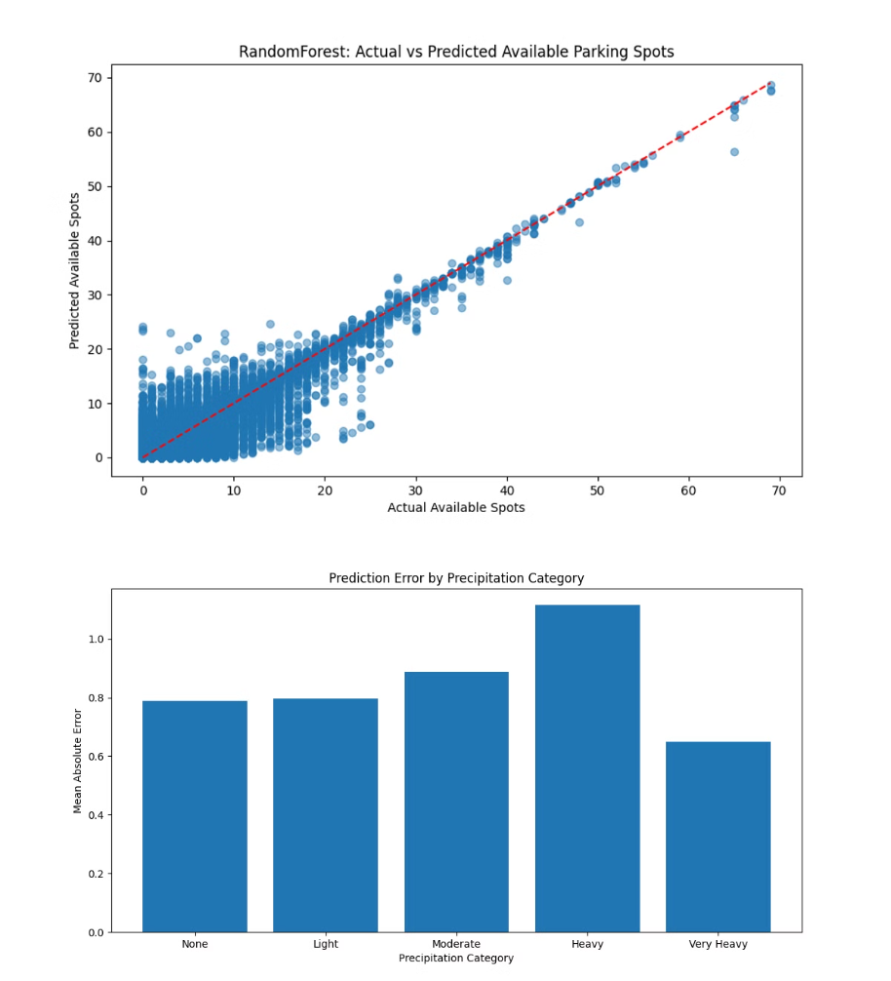



Inside the Crystal Ball
Our model achieves 83% accuracy in predicting parking availability. The hour of the day, precipitation, and day of the week are the top predictors. Extreme weather events show higher prediction errors. The mean squared error is 2.16 overall but rises to 3.07 during extreme weather.
1
Day and Time
2
Precipitation
3
Accuracy
Notes:
1. **Q: How did you determine feature importance in your models?**
**A:** We extracted feature importance directly from the Random Forest model using the `feature_importances_` attribute, as shown in our model.ipynb. This is a built-in capability of scikit-learn's Random Forest implementation that measures how much each feature contributes to decreasing impurity across all trees.
2. **Q: What were the top features in predicting parking availability?**
**A:** Based on our feature importance visualization (random_forest_complete_feature_importance.png), the top features included Parking_Spaces, Hour of day, Day_of_Week, and weather variables like temperature and precipitation. The exact ranking can be seen in the visualization.
3. **Q: Why is there a gap between your training R² (0.93) and validation R² (0.83)?**
**A:** This gap indicates some degree of overfitting, which is common in complex models. However, an R² of 0.83 on validation data is still very good and suggests the model generalizes well. We could potentially reduce this gap through additional regularization or simpler models, but might sacrifice some predictive power.

Slide 10



From Insights to Action
Implement dynamic pricing during forecasted rain. Focus weather-responsive planning on Downtown and South Lake Union. Plan for higher occupancy during rain and peak hours.
City Planners
Commuters
Future Directions
Implement dynamic pricing that increases by 15-20% during forecasted rain. Focus weather-responsive planning on Downtown and South Lake Union. Potential Impact: 30% reduction in parking search time during adverse weather
Plan for 15-20% higher occupancy during rain. Consider alternative transportation during 8-10 AM peak (85-90% occupancy)
Real-time dashboard development to monitor parking availability and weather conditions. Integration with traffic and public transit data to provide comprehensive transportation solutions.
Notes:
1. **Q: How would you implement a dynamic pricing system based on your model?**
**A:** We would deploy our model as an API that takes current and forecasted weather data as input and outputs predicted parking demand. This could then feed into a pricing algorithm that adjusts rates based on predicted demand, with higher prices during periods of high predicted demand and lower prices during periods of low demand.
2. **Q: Did you quantify the potential economic impact of implementing your recommendations?**
**A:** While our code doesn't explicitly calculate economic impact, we could estimate it by comparing current fixed pricing with optimized dynamic pricing based on our model's predictions. The difference in revenue, adjusted for potential changes in utilization, would represent the economic impact.

Slide 11

Thank You
Questions? Please don't hesitate to ask.
Notes:
## Slide 11: Future Work and Conclusion
1. **Q: What additional data would improve your model's performance?**
**A:** Additional data that would improve our model includes: special events data (sports games, concerts), public transit disruptions, construction projects, holidays and school schedules, and more granular microclimate data. These could be added as features to our existing model architecture.
2. **Q: How would you deploy this model in a production environment?**
**A:** For production deployment, we would: 1) Containerize the model using Docker, 2) Set up automated data pipelines for fresh weather and parking data, 3) Implement a REST API for real-time predictions, 4) Set up monitoring for model drift, and 5) Create a dashboard for visualizing predictions and actual parking demand.
## Technical Deep-Dive Questions
1. **Q: How did you handle the class imbalance in your target variable?**
**A:** Our target variable (Available_Spots) is continuous rather than categorical, so traditional class imbalance techniques don't apply. However, we did handle the skewed distribution by clipping negative values to zero, as seen in our model.ipynb: `df['Available_Spots'] = df['Available_Spots'].clip(lower=0)`.
2. **Q: What was the computational complexity of your Random Forest model?**
**A:** The computational complexity of Random Forest training is approximately O(n_trees * n_samples * log(n_samples) * n_features), where n_trees is the number of trees (typically 100-1000), n_samples is the number of data points (838,840 in our case), and n_features is the number of features (16 in our final model). This explains why our model took 733 minutes to train.
3. **Q: How did you ensure your code was efficient when handling such a large dataset?**
**A:** We implemented several efficiency measures: 1) Using pandas for vectorized operations instead of loops, 2) Selecting only necessary features for the model, 3) Using appropriate data types to reduce memory usage, and 4) Implementing parallel processing for model training when available.
4. **Q: How did you validate that your weather data accurately represented conditions at each parking location?**
**A:** We used regional weather data rather than trying to get hyperlocal conditions for each parking spot. This is a reasonable approximation given Seattle's relatively consistent weather patterns within regions. The elevation data helps account for some microclimate variations between regions.
5. **Q: What steps did you take to ensure reproducibility of your results?**
**A:** We ensured reproducibility by: 1) Setting random seeds (random_state=42) in our train-test splits and models, 2) Saving processed datasets and models to disk, 3) Documenting our methodology in code comments, and 4) Using version control (Git) to track changes to our codebase.
This comprehensive list of technical questions and answers should help you prepare for your presentation. The answers are based directly on your code and should accurately reflect your project's implementation. Good luck with your presentation!

